Slide 1

Detect, Respond, Recover
Let’s discover the Run part of DevOps

Slide 2
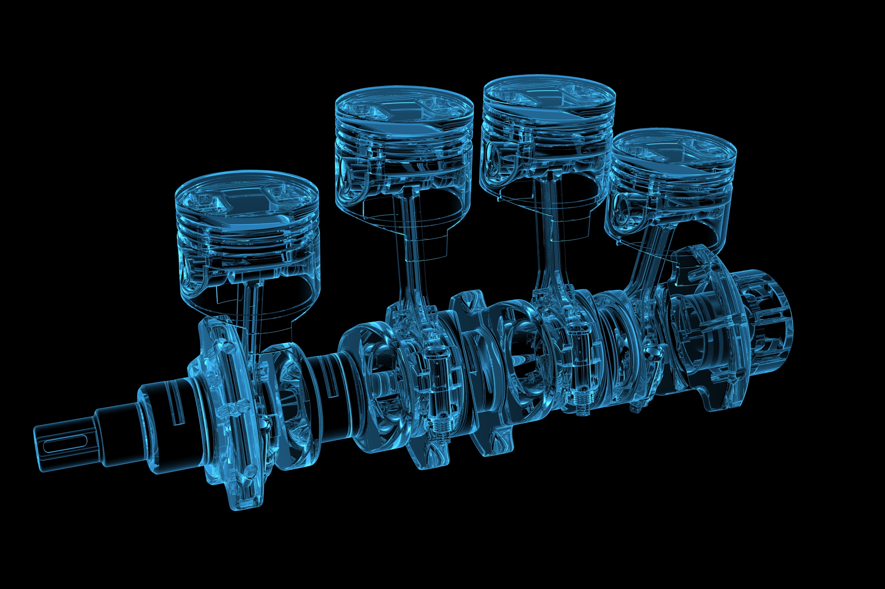

DevOps
DevOps is the union of people, process, and products to enable continuous delivery of value to our end users.
Continuous Integration
Continuous Delivery
Systems thinking
Feedback loops
Continuous learning
Notes:
Reliabillity

Slide 3
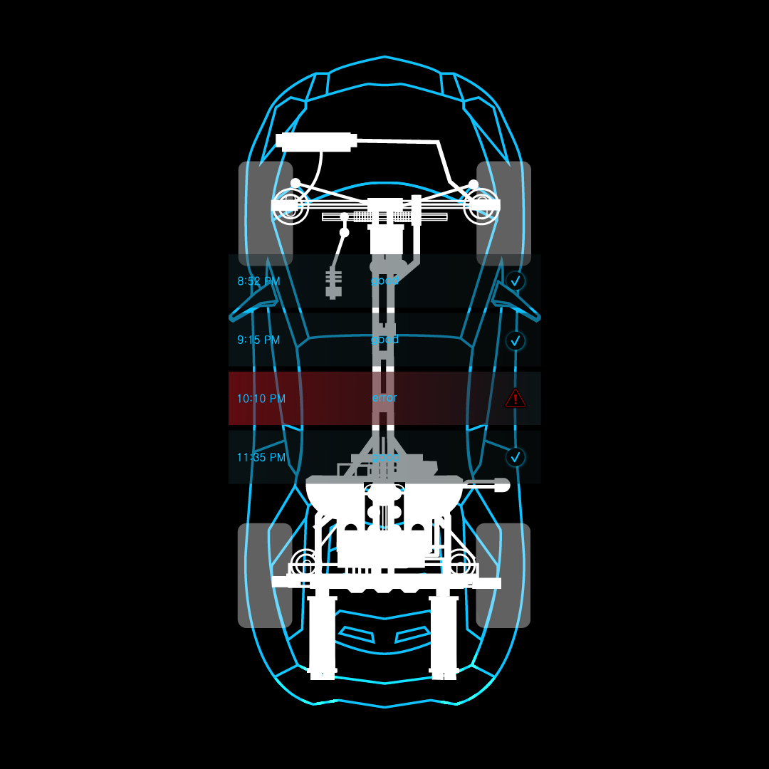
Introducing: Site Reliability Engineering (SRE)
Site Reliability Engineering is an engineering discipline devoted to helping an organization sustainably achieve the appropriate level of reliability in their systems, services, and products.
Reliability
Appropriate
Sustainably
Notes:
Reliabillity

Slide 4
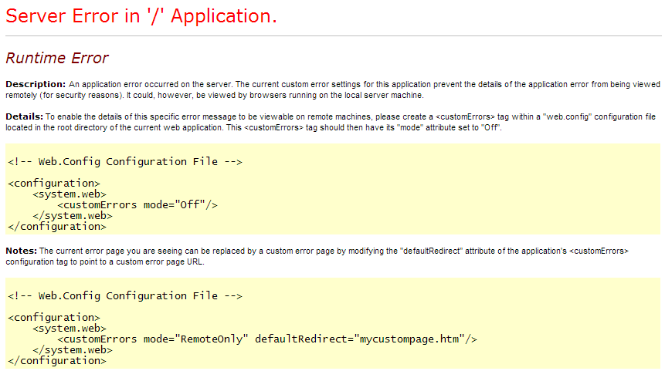
Reliability
Notes:
Reliability
This is how an ASP.NET application looks like when it fails <click>
This is an Java application that fails <click>
You can spend as many resources you want on building new features and change your organization to go faster, etc, but if your site is down, you trow all this effort away.
So reliability of the software is crucial, in order to be successful.

Slide 5
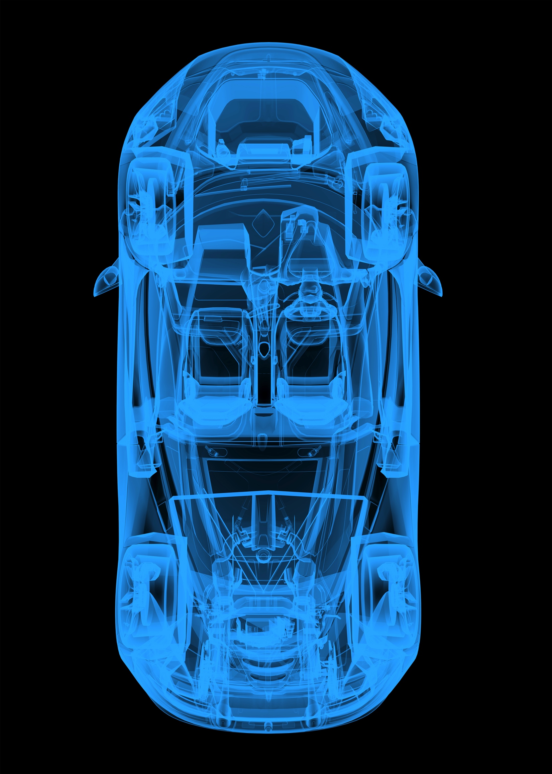
Appropriate
Except in rare cases, 100% reliability is never the right goal
Expensive, Unreachable and makes it reactive
Define your goals wisely
Service Level Objective
Service Level Indicator
Service Level Agreement
Notes:
Appropriate
Now the word appropriate. Except in rare cases, 100% reliability is never the right goal. This is different from our previous operational thinking. Not the right goal because: 1) often unreachable (dependencies or intermediate path may not be 100% reliable), 2) really expensive, 3) leaves you with no slack (error budgets), 4) everything is reactive (since it can only go downhill from there)
If your dependencies are not 100% reliable, then you can’t have 100% reliability.
If there is 100% reliability, how can you have the slack to change things..

Slide 6




Sustainable
Can’t make reliable systems with burned out people
Spend time on automation
Less on tickets, calls, plans, etc.
All overhead pulls them away from reliability projects
Notes:
Sustainably. SRE, like DevOps, recognizes that it is crucial that an operations practice takes into account the people (for example, with on-call rotations and the type of work they are expected to do). Can’t make reliable systems out of burned out people.
Sustainability is about the type of work as well. Spending all the time on tickets, frequent on-call pages, and other interrupt driven work pulls time and attention away from projects that increase reliability.

Slide 7


What is the difference between
DevOps and SRE
SREs
DevOps

Slide 8
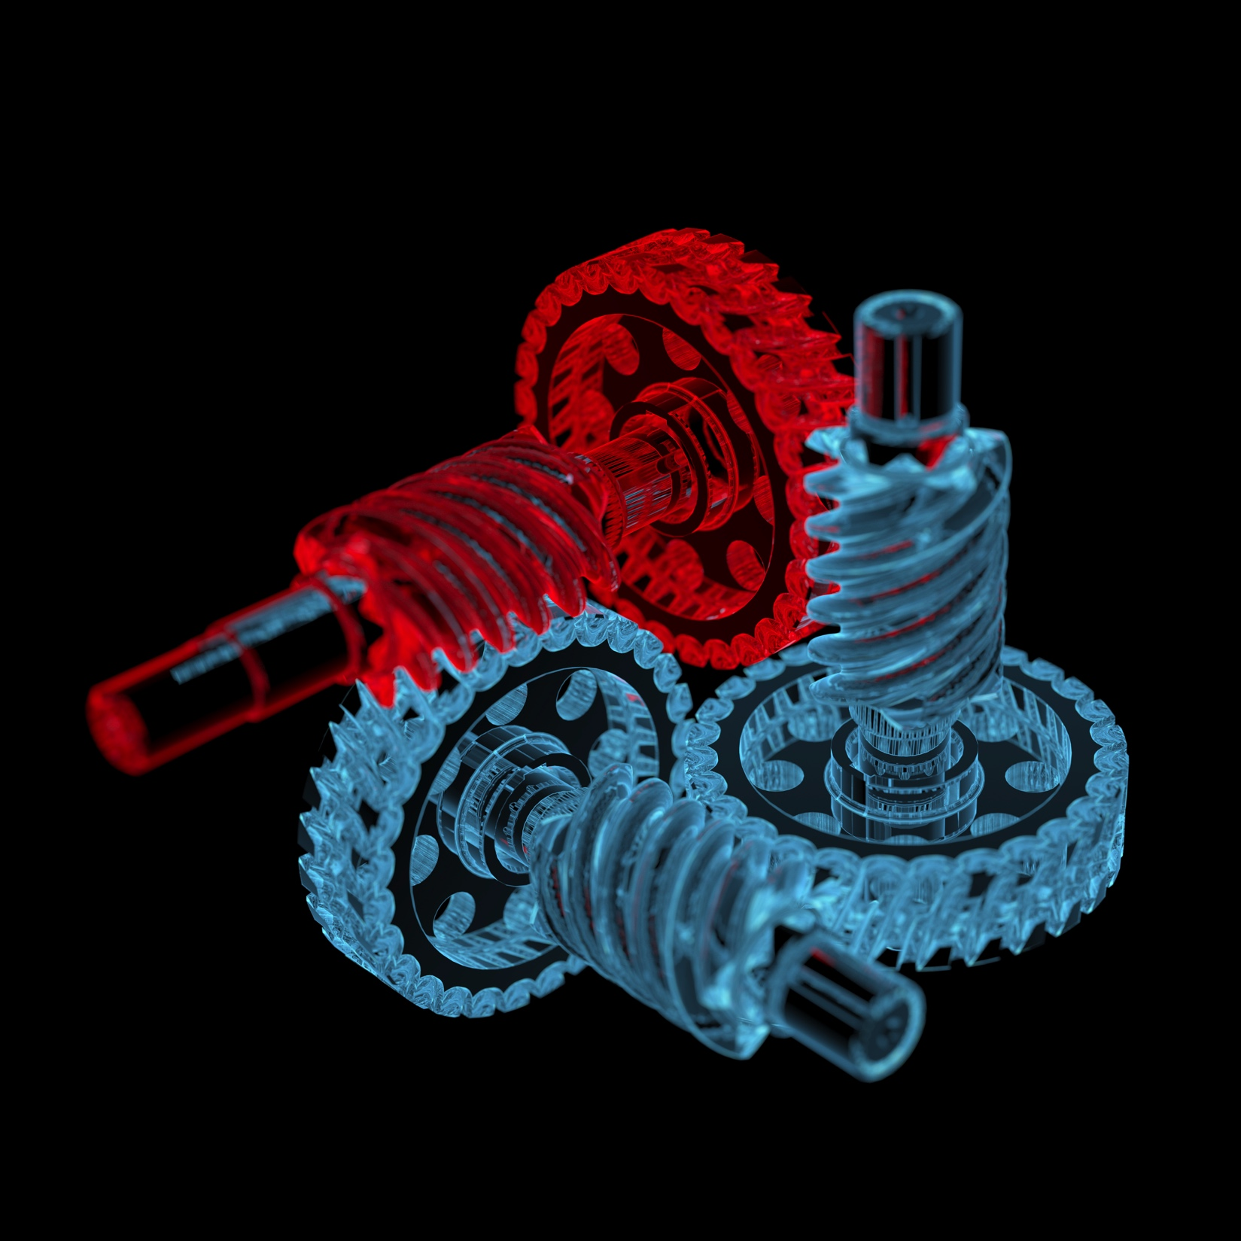
DevOps and SRE
It is not about DevOps vs SRE it is DevOps and SRE
SRE focusses on reliability
DevOps focusses on delivering value in a fast, secure, compliant and reliable way

Slide 9




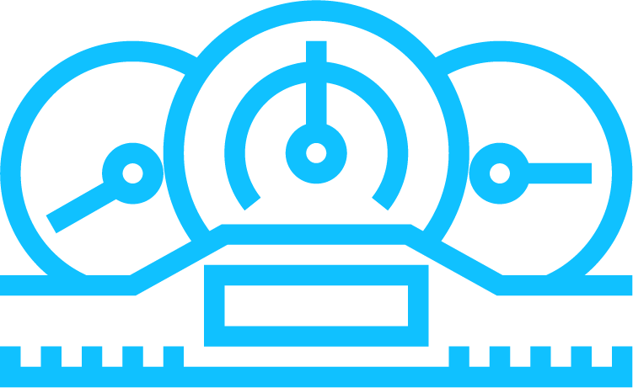
How would a journey look like incorporating SRE?

Slide 10

Meet Parts Unlimited Inc
Sells car parts on the internet
They invested a lot in DevOps in the last few years
They have CI/CD, They run all in the cloud
They live by the DevOps ways defined by Gene Kim
Systems thinking
Feedback loops
Continuous learning

Slide 11
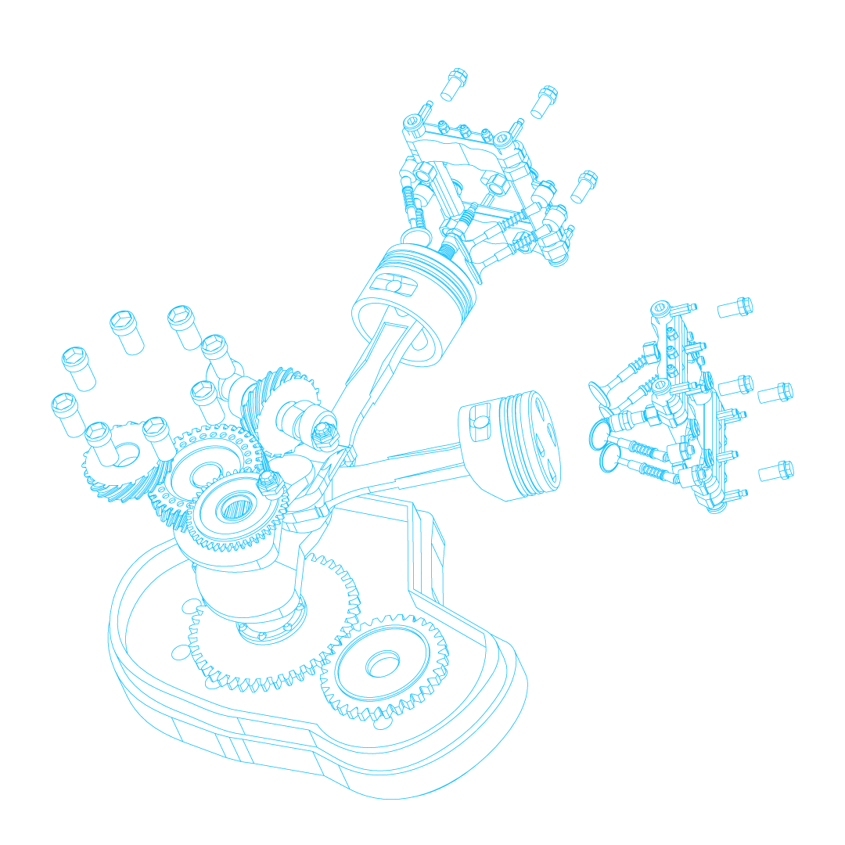
Challenges at Parts Unlimited?
How can we get a more stable operation
We have outages all the time
How can we improve our delivery while keeping all the good from DevOps?
How can we implement a process that re-enforces continuous learning from incidents that happen
How can we apply SRE practices
Error Budgets
Learning retrospectives (blameless post mortem)
Detect, Respond, Remediate

Slide 12
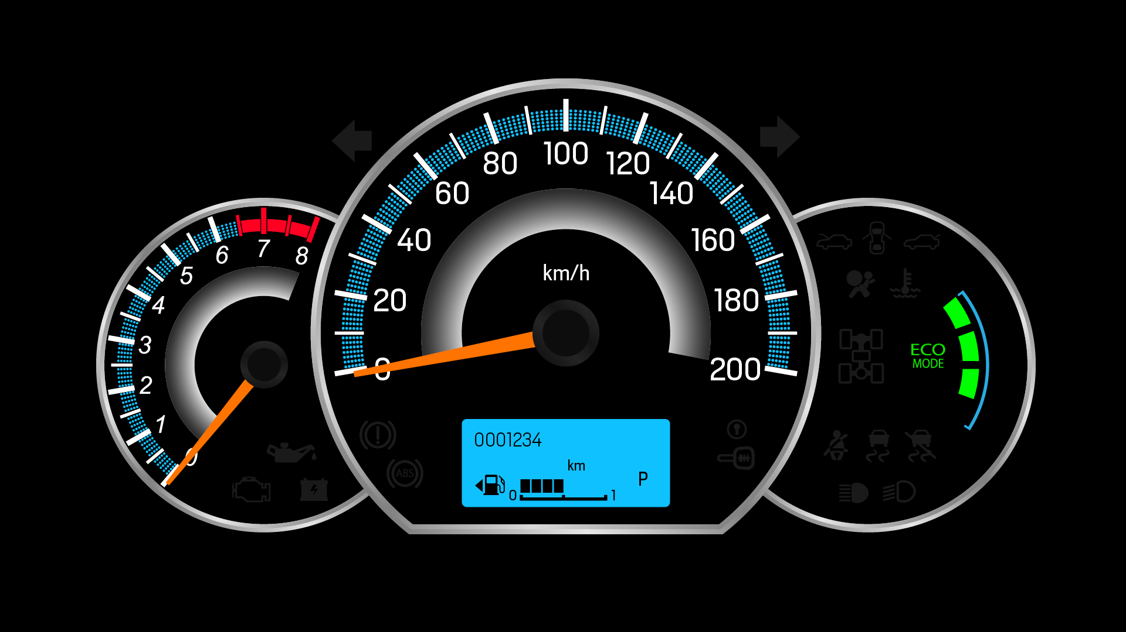
A journey through time
Let’s have a look at a year at Parts Unlimited, what they encountered and what they learned along the way.

Slide 13

February 2018
Notes:
February 2018, parts unlimited sales is going through the roof.
But from one moment on the other sales is dropping, what is going on?
Then one of the engineers comes in running, dude have you seen this issue with our website?
What is going on. When you go to the site and you want to buy pars, you will get this error in the browser.
We need to see what is going on.

Slide 14
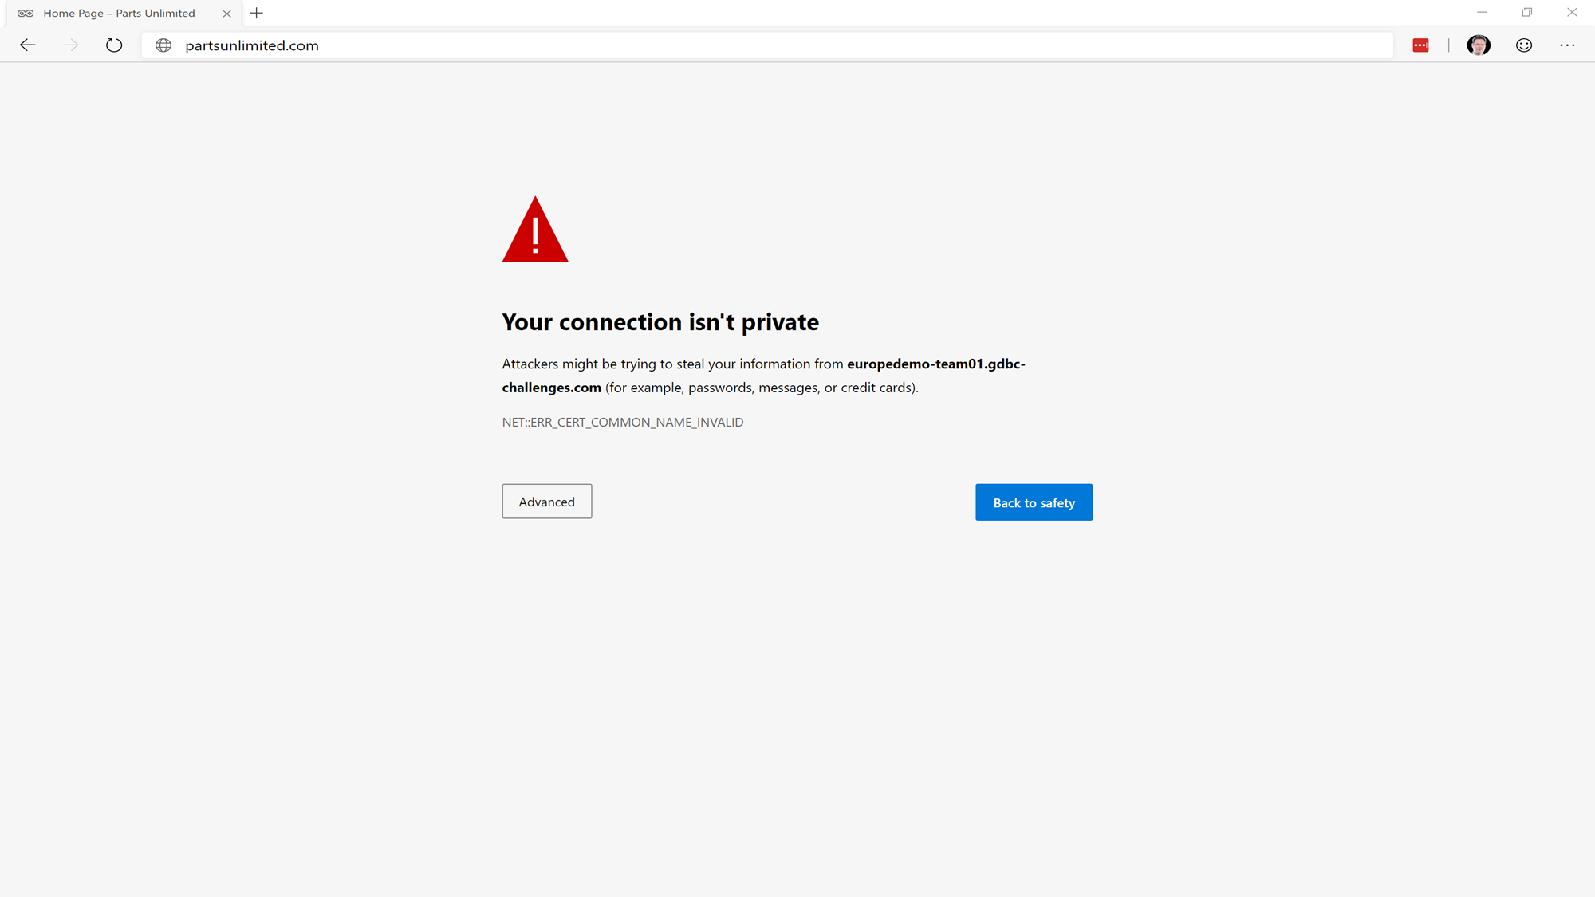
Site is showing this error

Slide 15
February 2018
Detect, Respond, Recover
This issue is detected by customers
Sales is dropping and makes engineers aware of the problem
How to fix?
Figure out what is going on
Apparently an certificate has expired, giving the error dialog
Quick Fix, replace the certificate

Slide 16
February 2018
Notes:
2 days later, same problem again
What is happening here?

Slide 17
Site is showing this error

Slide 18

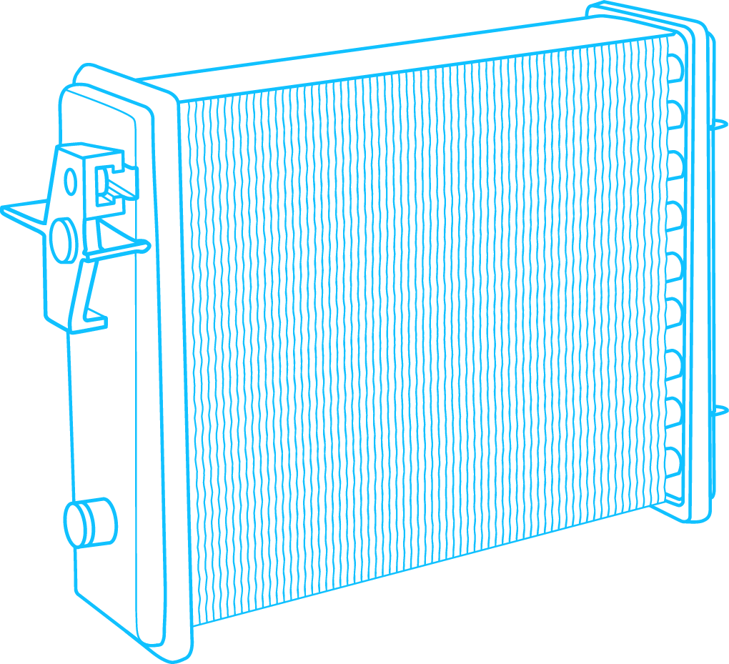

February 2018
Detect, Respond, Recover
Ooh no, not again
Same problem, certificate expired
Cause, well we fixed it a few days ago, but we did not remediate it for the long term

Slide 19





Introducing the postmortem
This is a meeting with all people from the DevOps and SRE teams assessing what went wrong, why it went wrong, how was it fixed and most important:
What is done to prevent this from happening in the future
All fix items will be placed on the backlog and implemented by the teams a.s.a.p.

Slide 20
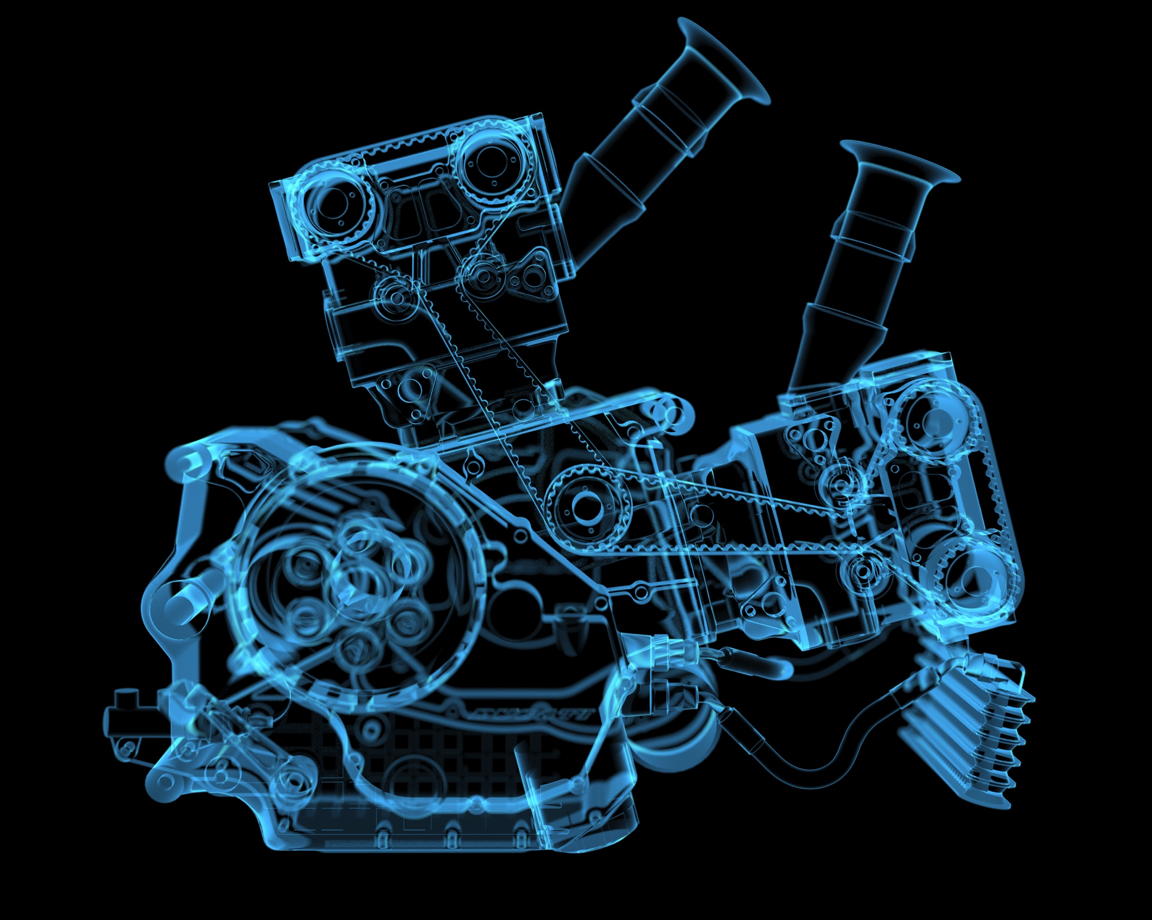
March 2018
Let’s go Open Source
Parts Unlimited open sources parts of their software as a media stunt
Their company CEO thought it was a great marketing opportunity, so the engineering team pushed the sources to GitHub
Notes:
An external employee has cloned the code from the internal repository and pushed the full code base to Github. Unfortunately the codebase also contained credentials to the SQL Server. Because the credentials pointed to a Parts Unlimited Azure subscription, the Azure Administrator received an email. In panic, he rotated the credentials of the SQL Server Users that is used in the connection string, not thinking of the consequences. You need to fix this! And fast.

Slide 21

March 2018

Slide 22
2 hours after going Open Source….
Notes:
Because the credentials pointed to a Parts Unlimited Azure subscription, the Azure Administrator received an email. In panic, he rotated the credentials of the SQL Server Users that is used in the connection string, not thinking of the consequences. You need to fix this! And fast.

Slide 23
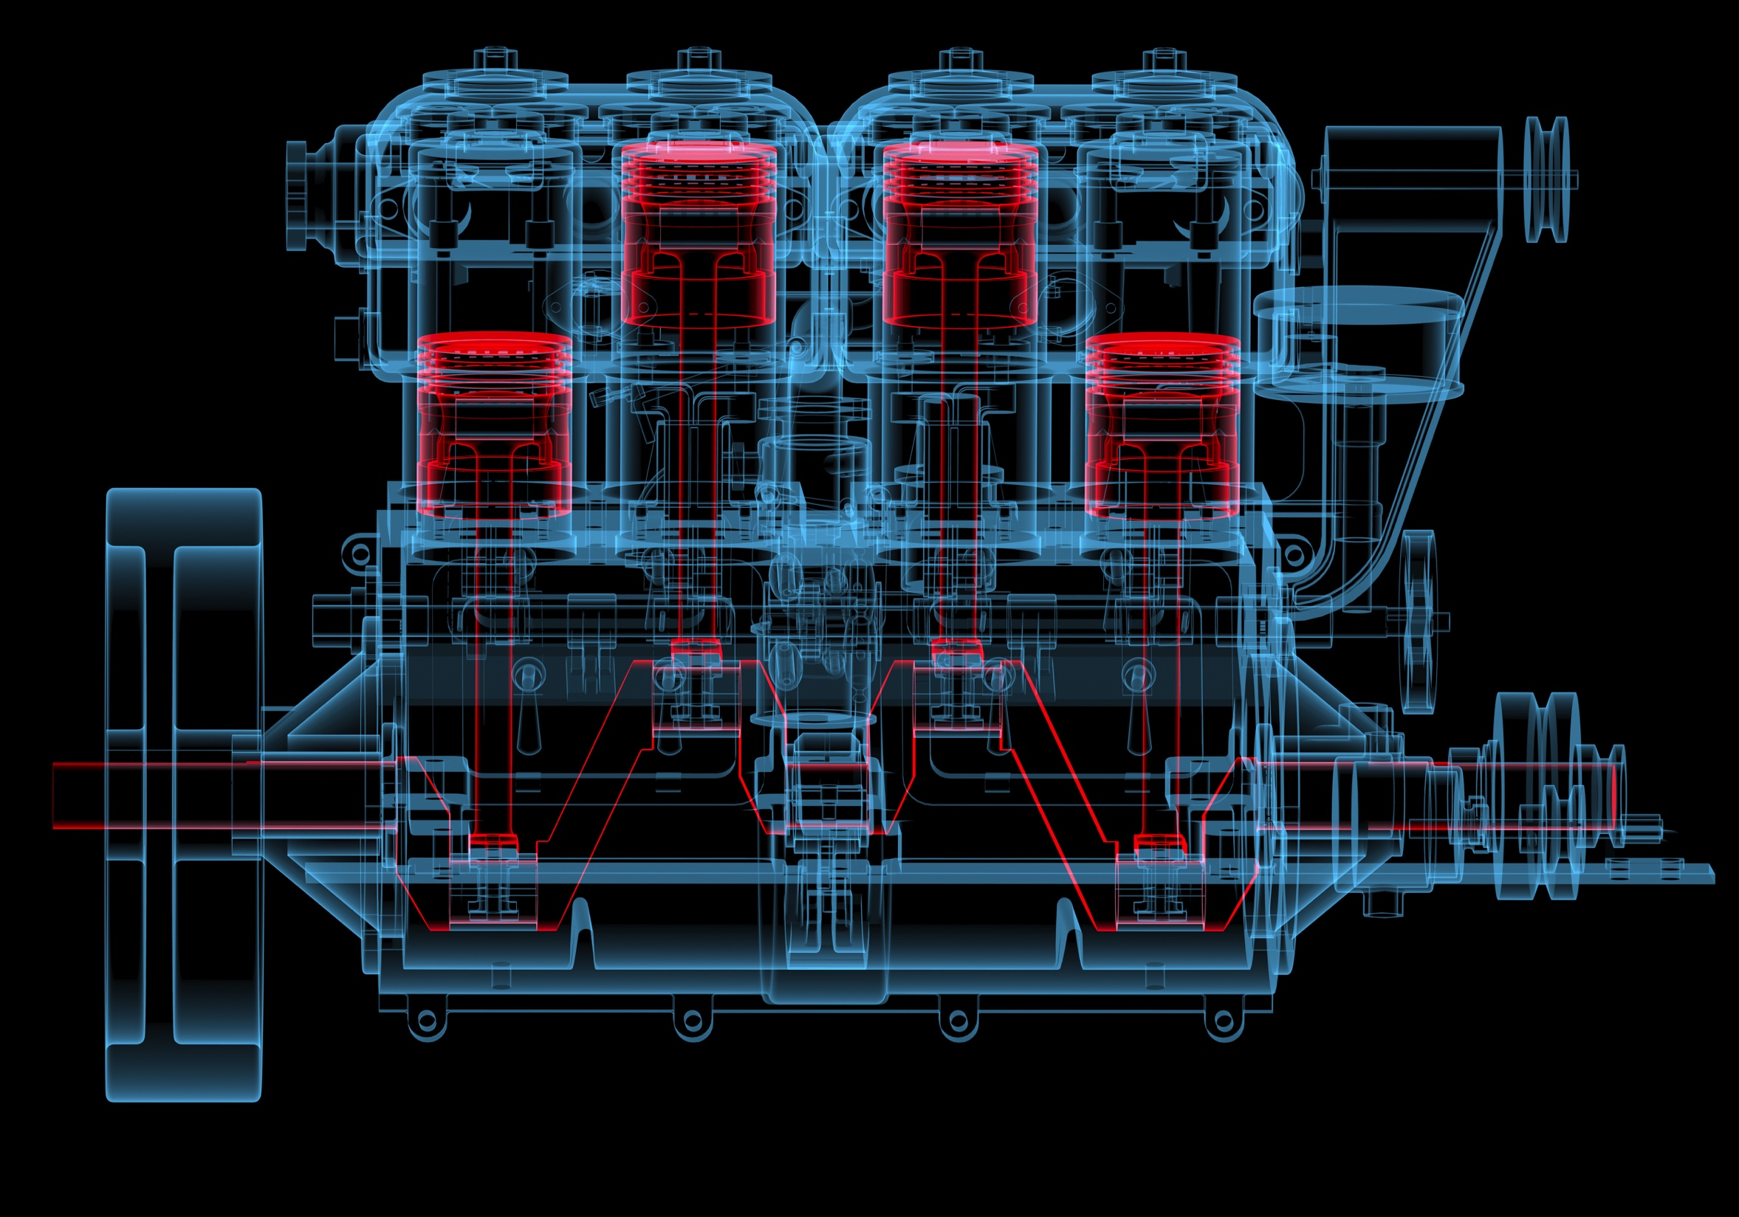
March 2018
Detect, Respond, Recover
Fast fix
Learning retrospective (blameless post mortem)
We need to stop putting our credentials in the repo
Backlog items
Add commit checks
Add credential scans on repo
Automate credential rotation
…
Long term
Detect credentials before commit

Slide 24
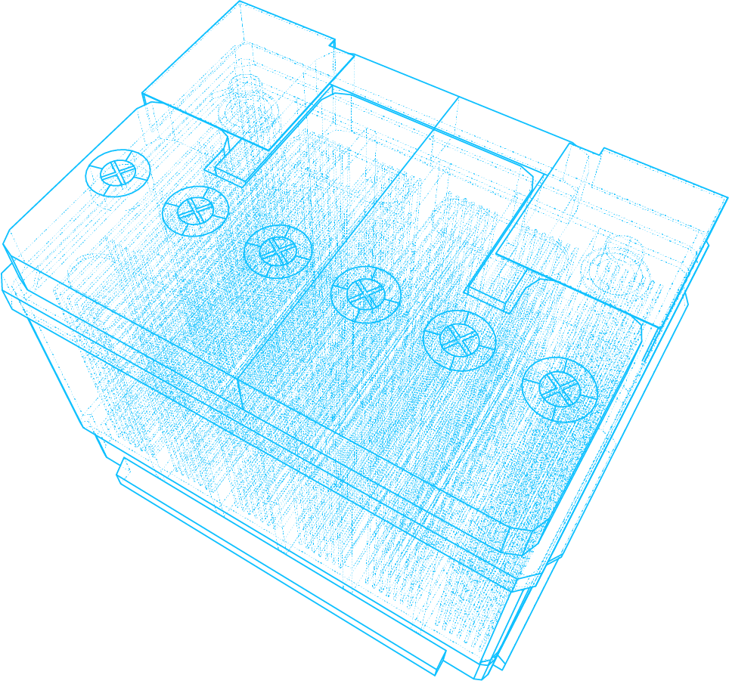
May 2018
CEO is on Oprah
Parts Unlimited just announced a great new deal for old car owners
Directs them to their website

Slide 25

May 2018

Slide 26
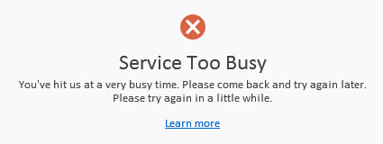
5 minutes after announcement….
Notes:
Because the credentials pointed to a Parts Unlimited Azure subscription, the Azure Administrator received an email. In panic, he rotated the credentials of the SQL Server Users that is used in the connection string, not thinking of the consequences. You need to fix this! And fast.

Slide 27





March 2018
Detect, Respond, Recover
Fast fix
Learning retrospective (blameless post mortem)
How do we prevent our servers from going down
How do we implement scaling
Backlog items
Add telemetry on usage
Implement auto scaling based on telemetry
Long term
Improve website performance

Slide 28

September 2018

Slide 29
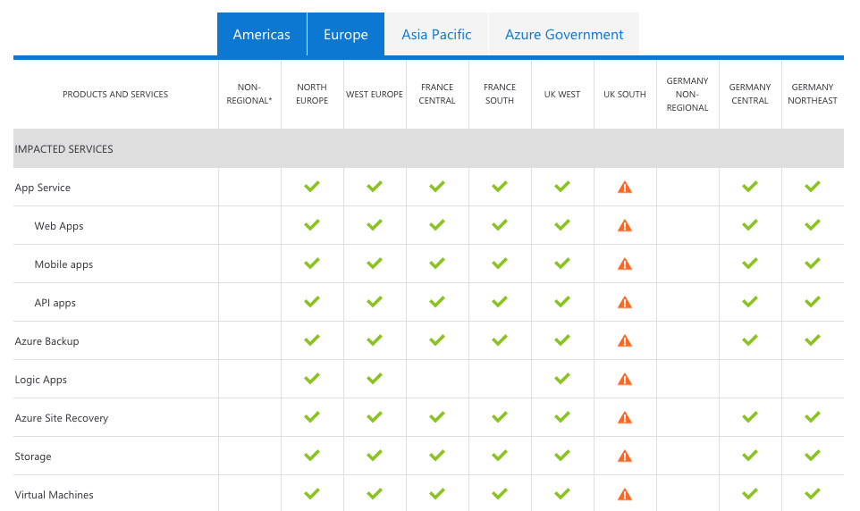
Parts Unlimited is unreachable
Lightning just struck the datacenter

Slide 30
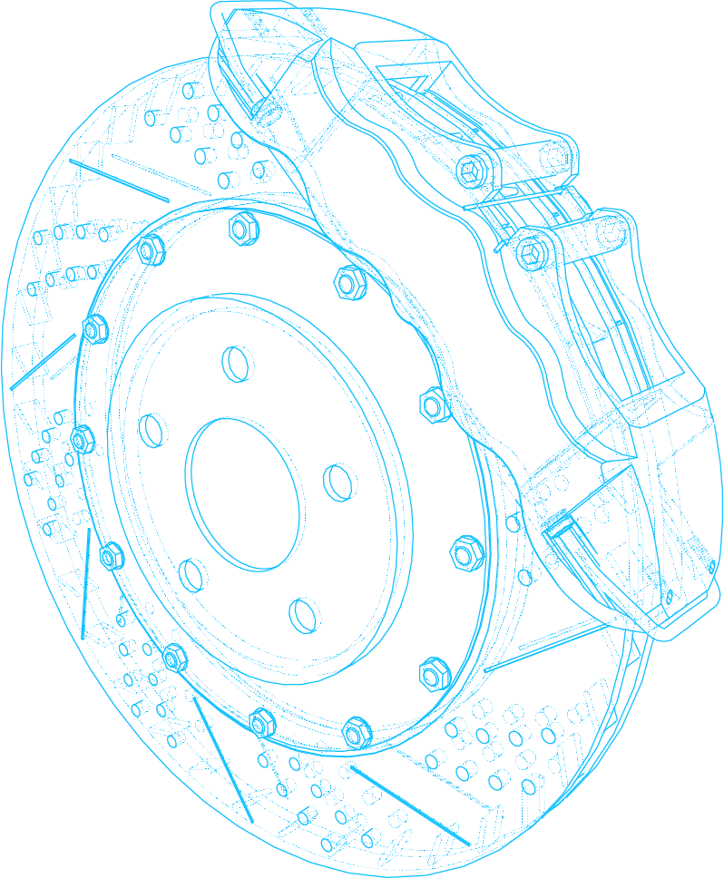
September 2018
Detect, Respond, Recover
Fast fix
Learning retrospective (blameless post mortem)
How do we implement a fail over in case of disaster
Backlog items
Ensure all infra is created with scripts
Create infra deployment pipelines
Long term
Add geo redundancy to infrastructure

Slide 31


December 2018

Slide 32
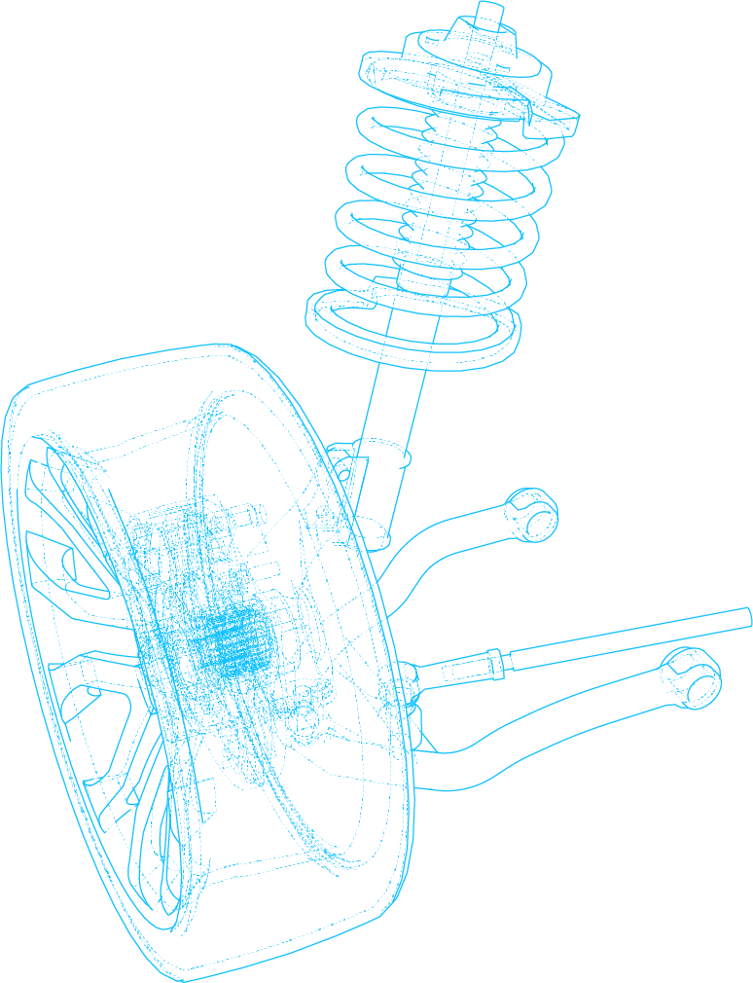
December 2018
New feature fast!
The CEO had a chat with a partner and he needs an update to the website fast
Push the developers to deliver it now! No excuses
They go and find this package that does all they need, this is too good to be true …

Slide 33

Roll out the new feature and…
Website is now a Bitcoin Miner, cause by the package

Slide 34
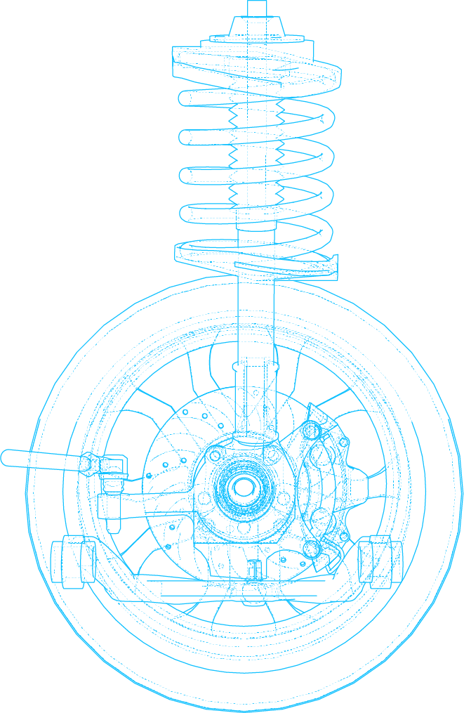
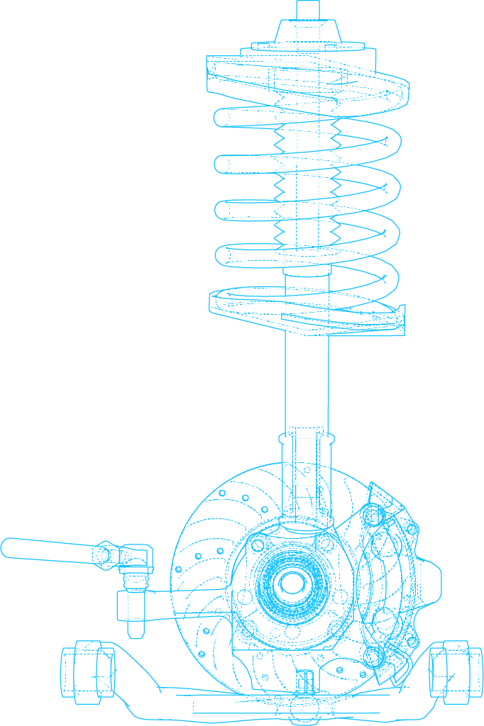
September 2018
Detect, Respond, Recover
Roll back the feature immediately
Run previous automated deployment
Learning retrospective (blameless post mortem)
The package contained a known vulnerability
This was found by someone and exploited to inject a Bitcoin Miner
How do we detect known vulnerabilities before we deploy to production?
Backlog items
Add package scanning to the pipelines
Start using a private package feed
Long term
Get another boss?

Slide 35

WOW that was quite a ride
What did we learn?

Slide 36
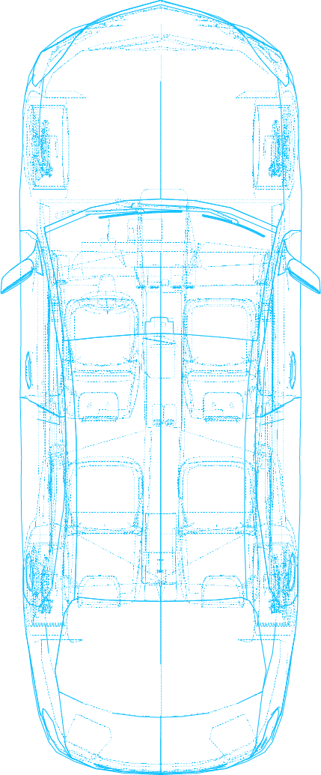
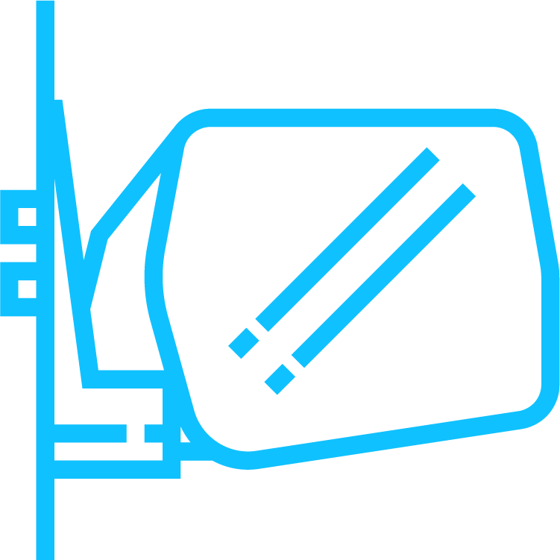


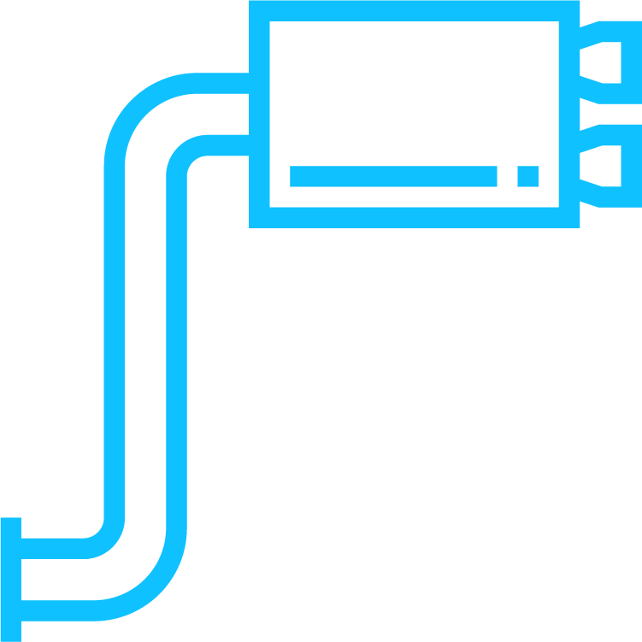












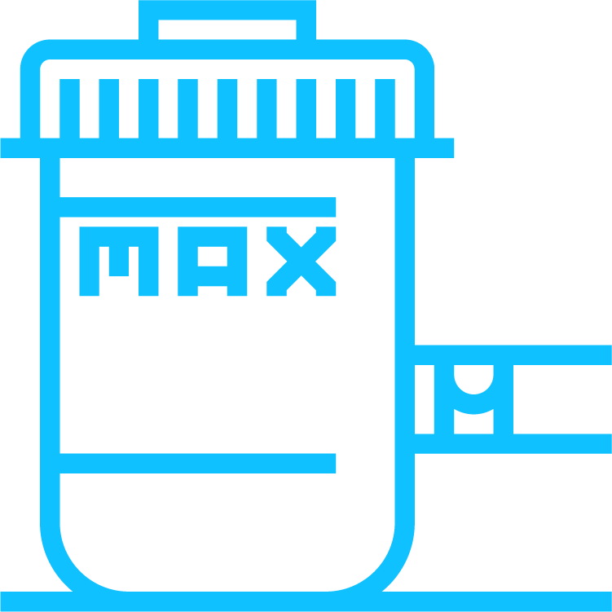






DevOps and SRE go hand in hand
We build new features and deploy them every day
We know how to mitigate the problem now
We constantly ask ourselves how do you prevent it for the future
Engineering for Stability and Availability is an important practice
You need to have engineers that have a focus on this
Make them part of the DevOps team!

